Slide 1


FED TAPERING
COMPOUNDING

Slide 2

Compounding refers to generating earnings from previous earnings.

Slide 3

COMPOUNDING
Let’s try to understand this with the help of an interesting story…

Slide 4

COMPOUNDING
The King of Persia and a peasant sat down one day to play a game of chess.
The King, with his noble birth, expensive education and strategic training was confident of an easy victory.

Slide 5
COMPOUNDING
Said the king to the peasant “If you win, I shall give you whatever you ask,”
However things didn’t go as the King had anticipated, and he was defeated
Expecting the peasant to demand half the kingdom, his daughter, or worst of all his fluffy Persian cat, the King was pleasantly surprised when the peasant asked for nothing but rice.

Slide 6
COMPOUNDING
“How much rice?” asked the King.
If it pleases your Majesty,” answered the peasant, “I would like one grain placed on the first square of this chessboard, two on the second, four on the third, eight on the fourth, and so on, doubling the number of grains with each square.”
The King, greatly relieved and thinking the peasant a worthless fool called his minister and ordered him to measure out the rice, put it in a bag, and send the peasant on his way.

Slide 7
COMPOUNDING
To the King’s horror, his minister informed him that there was not enough rice in the whole World, let alone Persia to honour his deal with the peasant.
In the fashion of tyrants when faced with ruin, the King had the peasant’s head cut off.
…now the numbers…

Slide 8

COMPOUNDING
If you wish to calculate how many grains of rice the peasant won, it’s 18,446,744,073,709,551,615, or about 18 quintillion!!

Slide 9
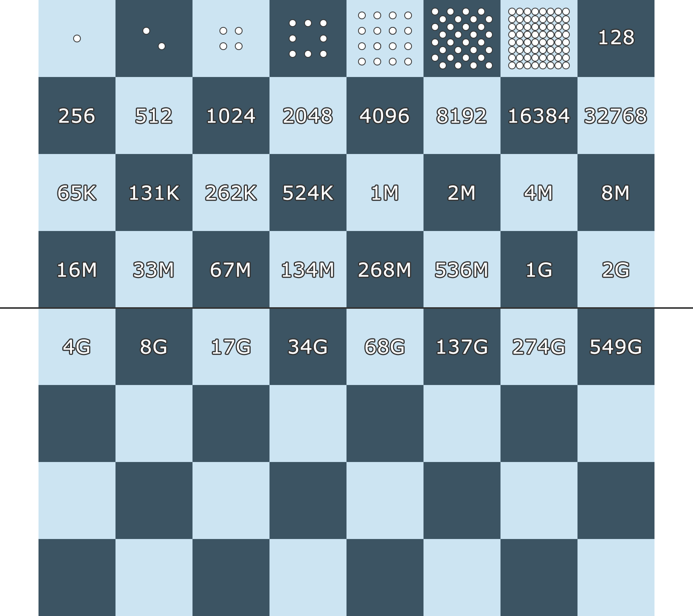
COMPOUNDING
As you can see, if an average grain of rice weighs roughly 10 milligrams, this much rice would weigh about 15 times as much as Mt. Everest!!

Slide 10
COMPOUNDING
This is what is popularly known as the ‘Power of Compounding’.

Slide 11
COMPOUNDING
Hope this story succeeded in clarifying the concept of Compounding.

Slide 12

Please give us your feedback at
professor@tataamc.com

Slide 13

DISCLAIMER
The views expressed in this lesson are for information purposes only and do not construe to be any investment, legal or taxation advice. The lesson is a conceptual representation and may not include several nuances that are associated and vital. The purpose of this lesson is to clarify the basics of the concept so that readers at large can relate and thereby take more interest in the product / concept. In a nutshell, Professor Simply Simple lessons should be seen from the perspective of it being a primer on financial concepts. The contents are topical in nature and held true at the time of creation of the lesson. This is not indicative of future market trends, nor is Tata Asset Management Ltd. attempting to predict the same. Reprinting any part of this material will be at your own risk. Tata Asset Management Ltd. will not be liable for the consequences of such action.
Mutual Fund investments are subject to market risks, read all scheme related documents carefully.

